Slide 1
Digging Students Out of the Summer Reading Slump Through a District/University Partnership
National Network for Educational Renewal, October 13, 2017
Hannibal-LaGrange University
Julie Jackson Albee, PhD
Larinee Dennis, PhD
Notes:
Each of us introduces ourselves. Julie will share “feel free to interrupt us with any questions.”

Slide 2
Getting To Know You . . .
Who is a public school teacher?
Who is a public school administrator?
Who is higher education faculty?
Who is a college student?
Other positions?
Notes:
Julie leads

Slide 3
The Reason for the Project
Summer Reading Setback is well-documented (Allington, McGill-Franzen, Camilli, Williams, Grafff, Zeig, Zmach, & Nowak, 2010; Alexander, Entwisle, & Olson, 2007; Allington & McGill-Franzen, 2003; Cooper, Nye Charlton, Lindsay & Greathouse, 1996; Entwisle, Alexander, & Olson, 1997).
A research study involving 1,300 students, found that children from low-income families lose several months of reading skills over the summer months. More than 80 percent of the rich/poor reading gap accumulates during summers (Allington, et. al, 2010).
Ritchie and Bates (2013) found the second grade reading achievement predicts what students’ income will be when they are in their 40s.
Notes:
Julie leads

Slide 4
What Can We Do to Reverse this Slump?
Gather a research team—reading professors from Hannibal-LaGrange University and at least one teacher from each of Hannibal’s 5 elementary schools (mostly Title 1 teachers).
Search educational literature to find possible solutions.
Write a grant to the Riedel Foundation to support purchasing materials for the intervention. ($1,500 Year 1, $1,500 Year 2, $1,000 Year 3--$4,000 total for 600 bags 100 bags in 2015, 200 bags in 2016 and 300 bags in 2017, $6.67 - $10.00 average cost per bag)
Notes:
Larinee leads

Slide 5
The Process Continued— search for free resources
4. FACT--Families and Communities Together—donated backpacks left over
from project.
5. Mother of a professor got some free books from Scholastic.
6. At the International Literacy Association Convention, a vendor gave us 100
bags free.
7. Missouri Conservationist donated a free Explor magazine for each student
and a card to complete for a free subscription.
What other free resources do you know?
Notes:
Larinee leads

Slide 6
The Process Continued . . .
8. Based on research of reading skills and teaching experience, determine
contents of “Dig Into Reading” materials during 2014-15 to send home with
students the summer after kindergarten
9. Summer 2015, send home 100 “Dig Into Reading” bags with kindergarten
students.
10. Repeat process during 2015-16 to determine materials for first grade
students.
11. Summer 2016, send home 200 bags—100 with kindergarten students and
100 with first grade students.
Notes:
Julie leads

Slide 7
The Process Continued . . .
12. Collect reading data each May and August/September.
13. Repeat process during 2016-17 to determine materials for second grade students.
14. Summer 2017, send home 300 bags—100 with kindergarten students, 100 with first graders, and 100 with second graders
15. 2017-18, complete data analysis and shift responsibility for “Dig Into Reading” materials to Hannibal Public Schools’ Title Reading.
Notes:
Julie leads

Slide 8
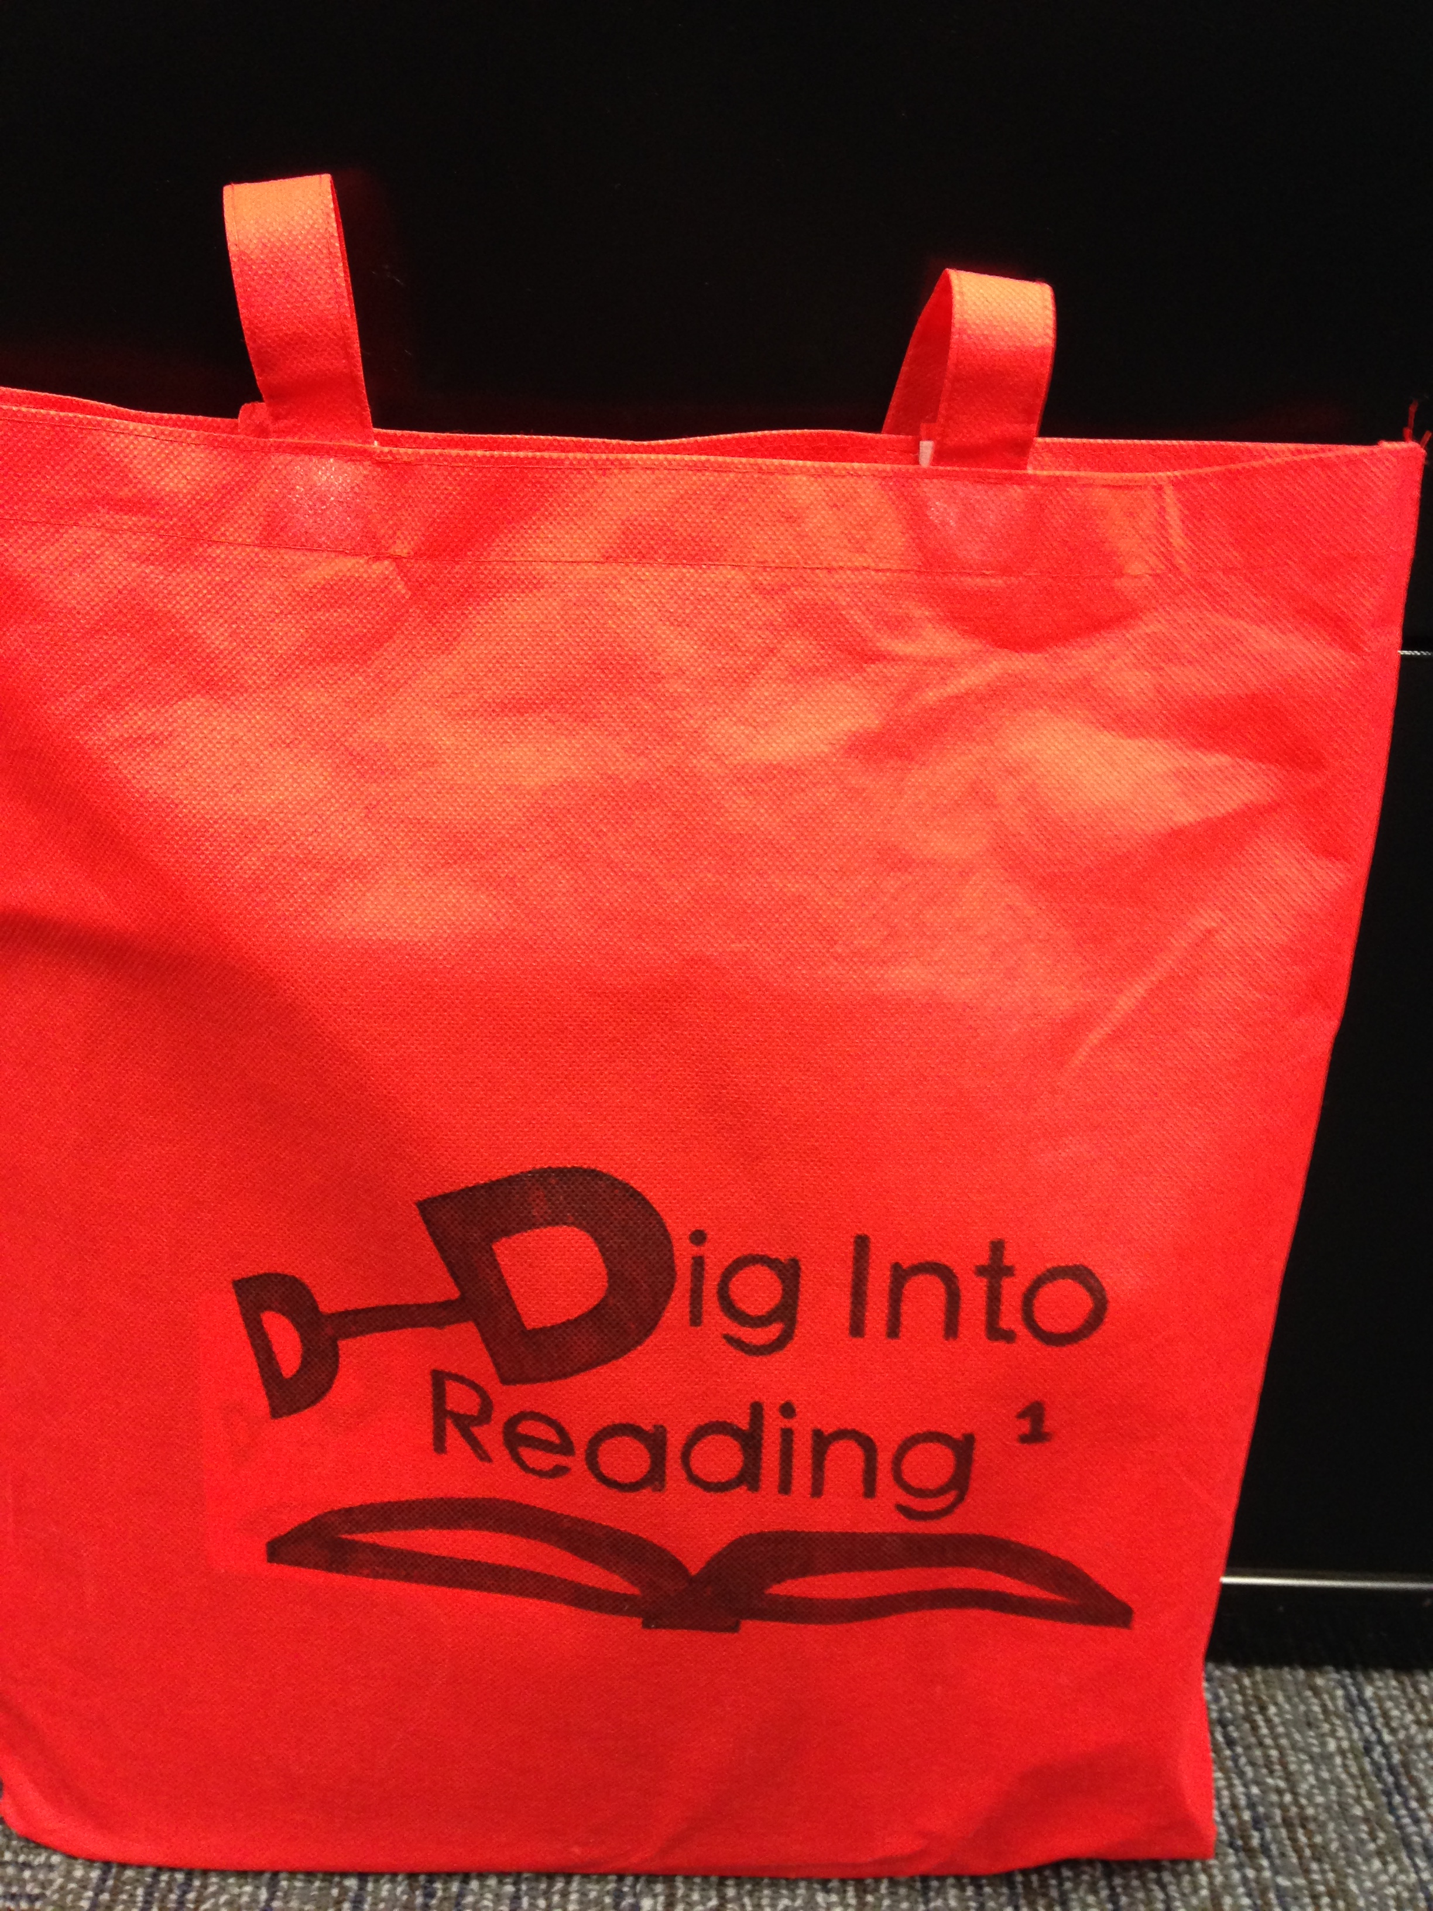
What is the Best Packaging?
Cost and quality were issues
Cheap bags—may not be returned
Marker bled on linen
Different styles for different grades
Oriental Trading—bright color tote bags,
glued Velcro to keep it closed
Free bags from vendor at ILA Conference
Donated backpacks from a local community organization
Notes:
Larinee leads

Slide 9
Should We Have a Logo?
Brainstormed possible logos.
A template was made by friend in the HLGU Public Relations office.
Using a black or silver Sharpie, hand-stenciled the logo on each bag—1 (Kdg.), 2 (1st) and 3 (2nd) were added to denote grade levels.
Printing would increase price to around $5.00 per bag.
How many bags will be returned each year?
Notes:
Larinee leads

Slide 10
What did Hannibal Public School teachers do?
Teachers from three of the five elementary schools met with the Research Team monthly to select and create the materials that went into the bags. Some were classroom teachers and some were Title 1 teachers.
Title 1 teachers had their students play the games in class, so students became familiar the games before the students took the materials home.
Notes:
Julie Albee

Slide 11
What did Hannibal Public School teachers do?
In May and August/September, Title Reading teachers assessed the students using Fountas and Pinnell’s Benchmark and reported each child’s level.
In May and August/September, Title Reading teachers assessed Fry’s Sight Word List and reported the number correct.
Title teachers chose the students to receive the “Dig Into Reading” materials (most struggling readers).
Notes:
Julie Albee

Slide 12
Hannibal-LaGrange University contributed:
1. Chair for the research team and meeting location.
2. Chair wrote the grants.
3. HLGU Media Communication student made the videos as part of his final project.
4. HLGU Art student created the alphabet cards.
Notes:
Larinee leads

Slide 13
Hannibal-LaGrange University contributed:
5. Campus Community Helpers (retired supporters of HLGU) and Retired Teachers Association group helped put together the materials.
6. Student workers in the Education Department helped with logos on bags, cutting games cards, etc.
7. Education Department bought some books through National Association for the Exchange of Industrial Resources (NAEIR) catalog (only cost of postage).
Notes:
Larinee leads

Slide 14
Reading Skills in Dig Into Reading bags
Introduction to Reading Skills video
In 2015, a DVD was produced with the directions for each activity. In 2016, this was changed to QR codes for each section.
Notes:
Larinee leads

Slide 15
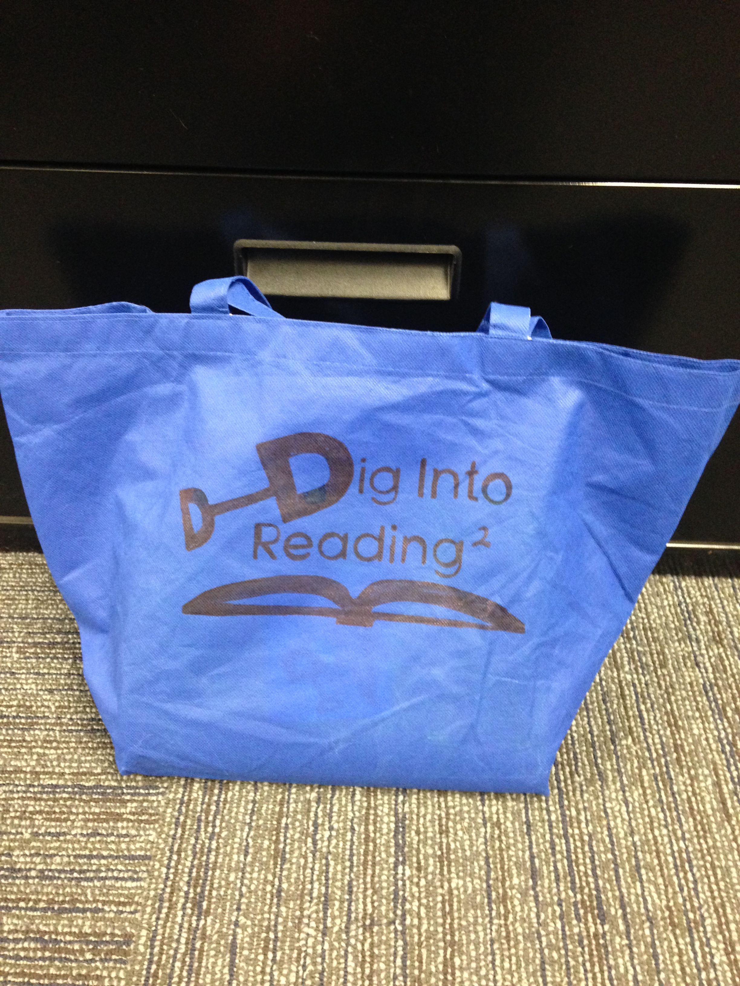
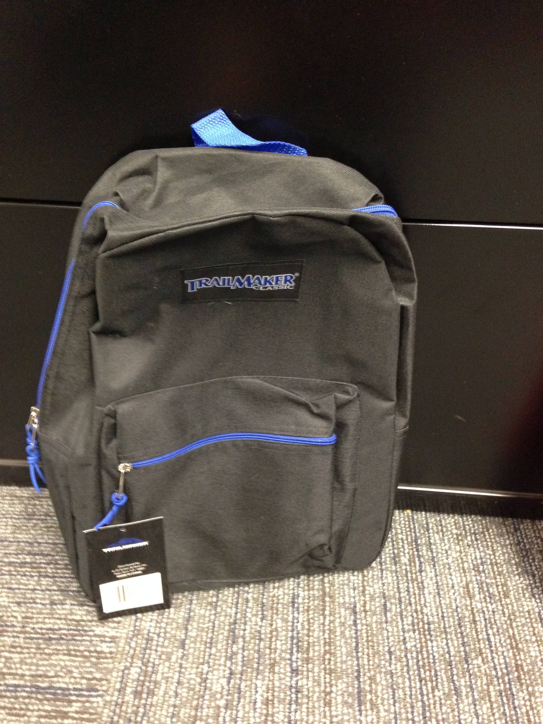
What’s inside the “Dig Into Reading” bag?
Kindergarten
2nd Grade
1st Grade
Notes:
Julie leads

Slide 16
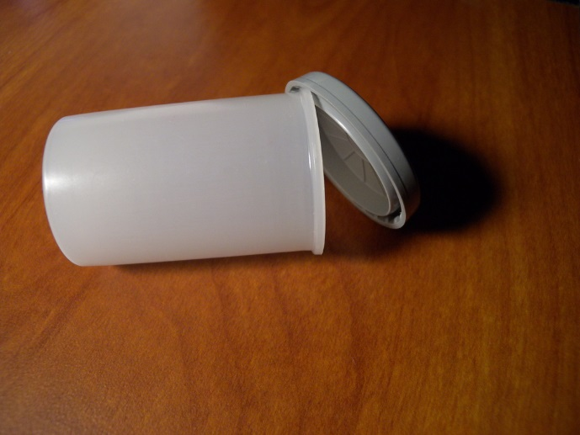
What Research-Based Activities Were Included?
Boom! Directions
Boom! Fry’s instant words
First 25 instant words make up 1/3 of all text (up to 8th grade)!
First 100 instant words make up about ½ of all text (up to 8th grade)!
First 300 instant words make up about 65% of all text (up to 8th grade)!
Kdg.—words 1 – 50 1st grade—words 25 – 75
2nd grade—word 100 - 150
Notes:
Julie leads

Slide 17
Kindergarten—Sight Word Snake game
Contains Fry’s sight words
Markers for 4 players—colored paper clips
Notes:
Julie Albee

Slide 18
Alphabet Activities
Trend alphabet border—cut apart the letters
Replaced with an alphabet drawn by an HLGU Art Major, with a clear anchor word for each letter
Notes:
Julie leads

Slide 19
Fry’s Instant Words Phrases (1st gr.)
Fry's Sight Word Phrases
Most common phrases where the instant words appear
The game “Climb the Ladder” (in 1st grade Dig Into Reading materials) uses instant word phrases
Notes:
Larinee leads

Slide 20
Building Words Phonograms/Rimes from Fountas & Pinnell’s List
Phonograms:
What are the 37 most common rimes?
 | -ack -all -ain -ake -ale -ame -an -ank -ap -ash | -at -ate -aw -ay -eat -ell -est -ice -ick | -ide -ight -ill -in -ine -ing -ink -ip -it | -ock -oke -op -ore -or -uck -ug -ump -unk
About 500 easy to read, high frequency words can be derived from only 37 rimes (Wylie & Durrell, 1970).
Notes:
Larinee leads

Slide 21
Roll-Say-Keep Kdg. – short vowels, 1st—short and long vowels, 3rd—double vowels and vowels with silent e
Roll-Say-Keep Directions
QR Codes take parents to directions for all activities in the packet.
Used Fountas and Pinnell Phonogram Word Lists
List 1—Kindergarten List 2—1st grade List 3—2nd grade
Notes:
Larinee leads

Slide 22
Books, Books, and More Books!!
4 books for parents to read aloud to students
Bookmark of questions to ask the child
7 books for student to read independently
Child Reading Aloud
Online resources for electronic texts with QR codes
Notes:
Larinee leads

Slide 23
Students get to keep 4 books Rhymes and Songs, Nursery Rhymes (to encourage Phonemic Awareness) 4 books that students keeps (Keep Books from Ohio State University—25 cents each)
Nursery Rhymes (not leveled)
Little Miss Muffet; One, Two, Buckle My Shoe; Mary Had a Little Lamb, . . .
Notes:
Larinee leads

Slide 24
What Was the Summer 2014 Kindergarten Baseline Data? *
May to August/September data
(level F and below)
105 students—lost 134 reading levels
(-134 levels divided by 105) =
average of -1.28 levels lost per child
Notes:
Julie leads

Slide 25
What Were the Intervention Summer 2015 Results for Kindergarteners?
2015 May to August/September data
85 students—lost 66 reading levels
(-66 levels divided by 85) =
average of -0.78 level lost per child
Notes:
Julie leads

Slide 26
What Were the Intervention Summer 2016 Results for Kindergarteners?
2016 May to August/September data
86 students—lost 65 reading levels
(-65 levels divided by 86) =
average of -0.77 level lost per child
Notes:
Julie leads

Slide 27
What Were the Kindergarten Results From 2014 to 2016?
Baseline 2014 average -1.28 levels
*************************************************************
Intervention 2015 average -0.78 level
Intervention 2016 average -0.77 level
Notes:
Julie leads

Slide 28
What Was the Summer 2014 First Grade Baseline Data?
2014 May to August/September data
51 students—lost 91 reading levels
(-90 levels divided by 51 students) =
average of -1.76 levels lost per student
(2 schools did not report baseline data for first grade)
Notes:
Julie leads

Slide 29
What Was the Summer 2015 First Grade Reading Level Baseline Data?
2015 May to August/September data
35 students—lost 77 reading levels
(-90 levels divided by 51 students) =
average of -2.2 levels lost per student
(3 schools did not report baseline data for first grade)
Notes:
Julie leads

Slide 30
What Were the Intervention Summer 2016 Results for Reading Levels of First Graders?
2016 May to August/September data
81 students—lost 78 reading levels
(-78 levels divided by 81 levels) =
average of -0.96 level lost per child
Notes:
Julie leads

Slide 31
What Were the First Grade Reading Level Results v From 2014 to 2016?
Baseline 2014 average -1.76 levels
Baseline 2015 average -2.2 level
*************************************************************
Intervention 2016 average -0.96 level
Notes:
Julie leads

Slide 32
Sight Word Results—Summer 2016 Intervention (received Dig Into Reading materials)
86 Kindergarten Students average loss of 8.16
sight words (out 50)
80 First Grade Students average loss of 2.26
sight words (out of 75)
Notes:
Julie leads

Slide 33
Calendars Showing Daily Use of Dig Into Reading Materials
2015 Kindergarten
14 calendars returned out of 70 bags returned
20% return rate 43.4 days average
2016
61 calendars returned out of 123 bags returned
49.6% return rate 33.4 days average
Notes:
Julie leads

Slide 34
How Many “Dig Into Reading” Bags Were Returned?
August 2015 94 kindergarten bags sent 70 bags returned (12 empty)
August 2016 100 kindergarten bags sent 61 bags returned
100 1st grade bags sent 66 bags returned
Postcard reminder to read was sent to each child in early July.
Notes:
Jill leads

Slide 35
How Many Parent Feedback Forms Were Returned?
2015 94 forms given 18 returned 19% return rate
2016 200 forms given 80 returned 40% return rate
How often did you and/or your child use items from the packet?
2015 2016
4 several times a week 21 several times a week
7 once or twice a week 25 once or twice a week
11 students out of 18 46 students total out of 80 responses
Notes:
Jill leads

Slide 36
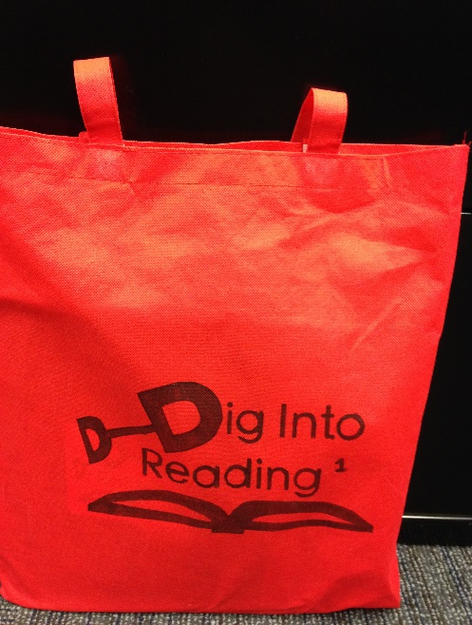
Feel free to look at the “Dig Into Reading” bags and at the conference handout
Notes:
Julie leads

Slide 37
References
Allington, R. L., & McGill-Franzen, A., Camilli, G., Williams, L., Graff, J., Zeig,
J., Zmach, C., & Nowak, R. (2010). Addressing summer reading setback
among economically disadvantaged elementary students. Reading
Psychology, 31, 411- 427.
Mraz, M., & Rasinski, T. V. (2007). Summer reading loss. The Reading Teacher,
60(8), 784 – 789.
Ritchie, S. J., & Bates, T. C. (2013). Enduring links from childhood mathematics
and reading achievement to adult socioeconomic status. Psychological
Science Online, Retrieved from doi: 10.11777/0956797612466268
White, T. G., & Kim, J. S. (2008). Teacher and parent scaffolding of voluntary
summer reading. The Reading Teacher, 62(2), 116-125.

Slide 38
Contact Information:
Julie Jackson Albee, jalbee@hlg.edu, 573-629-3105
Larinee Dennis, ldennis@hlg.edu, 573-629-3104

